Slide 1
Architecture review
Software Design Description

Slide 2
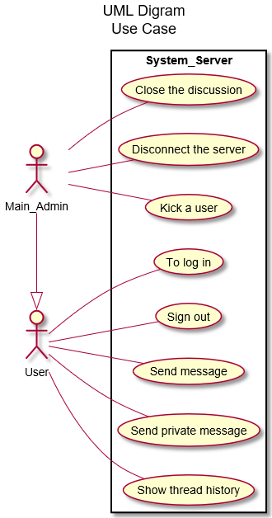
Use case Diagram
2 Actors :
Administrator
User
Administrator inherits from user
C:\Users\Thibault\Documents\NetBeansProjects\IRC_JEE\src\UML\UseCaseDiagram.svg

Slide 3
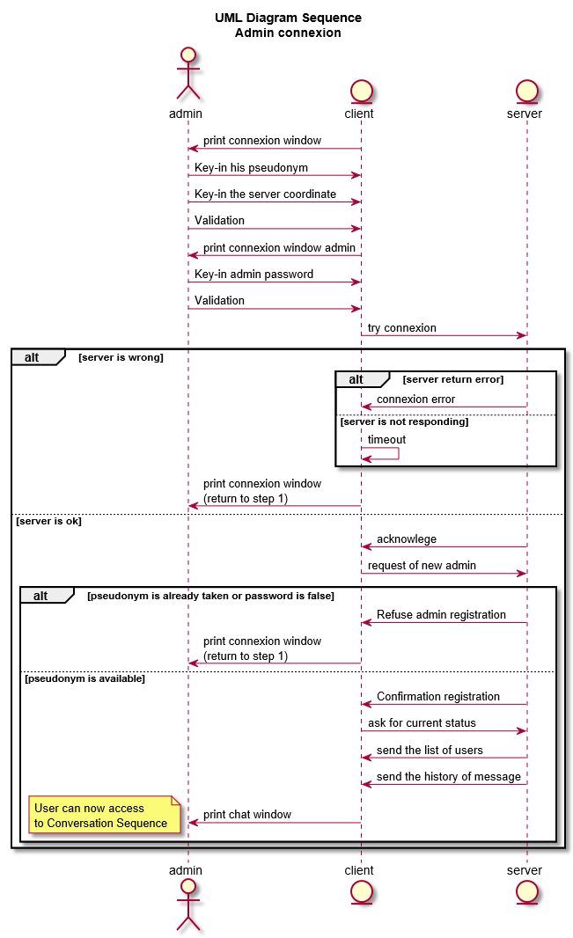
Administrator connection
Administrator connection to the server sequence
C:\Users\Thibault\Documents\NetBeansProjects\IRC_JEE\src\UML\AdminConnexionSequence.svg

Slide 4
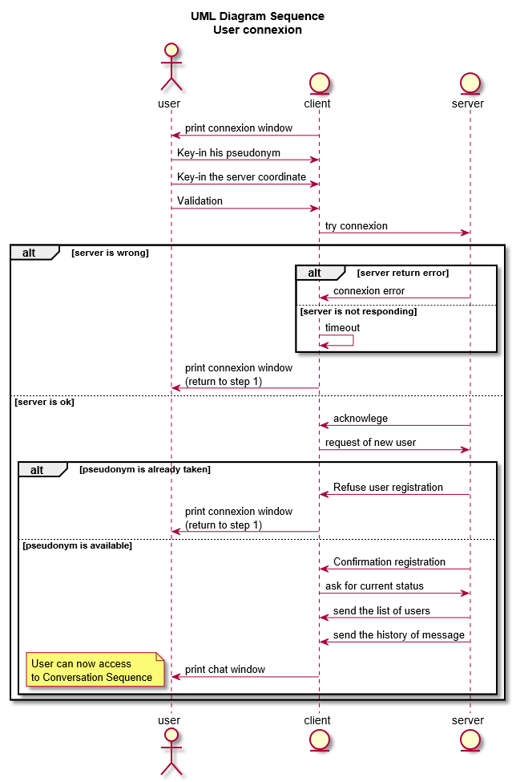
User Connection
User connection to the server sequence
C:\Users\Thibault\Documents\NetBeansProjects\IRC_JEE\src\UML\UserConnexionSequence.svg

Slide 5
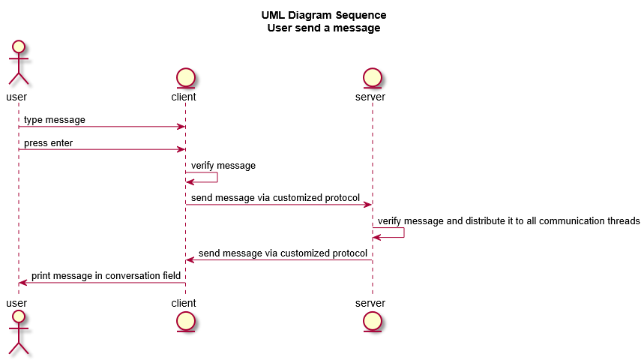
User send message sequence
C:\Users\Thibault\Documents\NetBeansProjects\IRC_JEE\src\UML\UserSendMessageSequence.svg

Slide 6
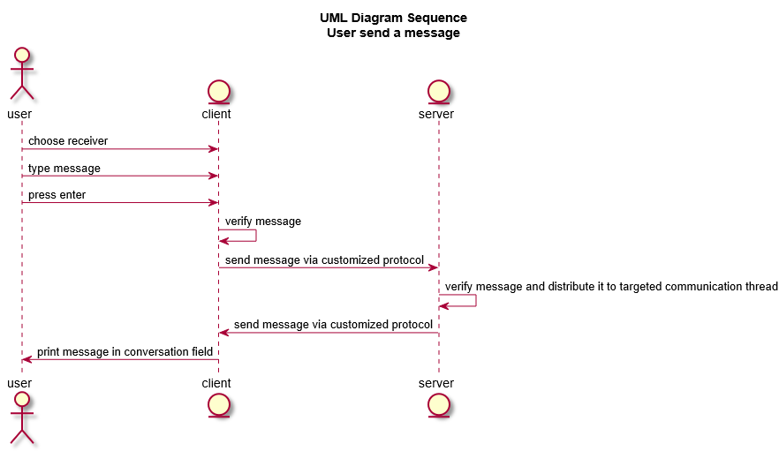
User send private message sequence
C:\Users\Thibault\Documents\NetBeansProjects\IRC_JEE\src\UML\UserPrivateMessageSequence.svg

Slide 7
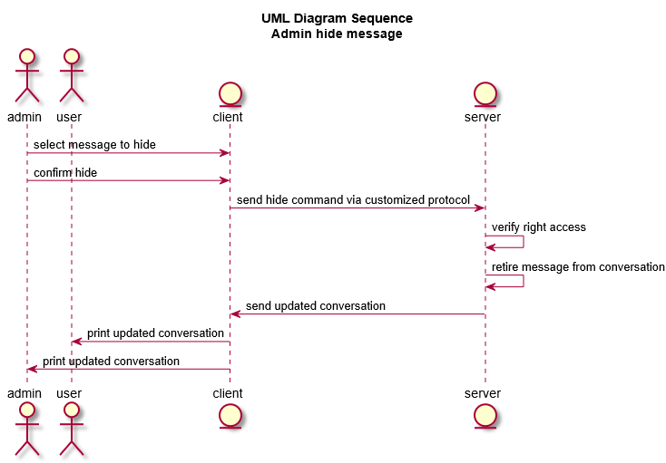
Administrator hide message sequence
C:\Users\Thibault\Documents\NetBeansProjects\IRC_JEE\src\UML\AdminHideMesessageSequence.svg

Slide 8
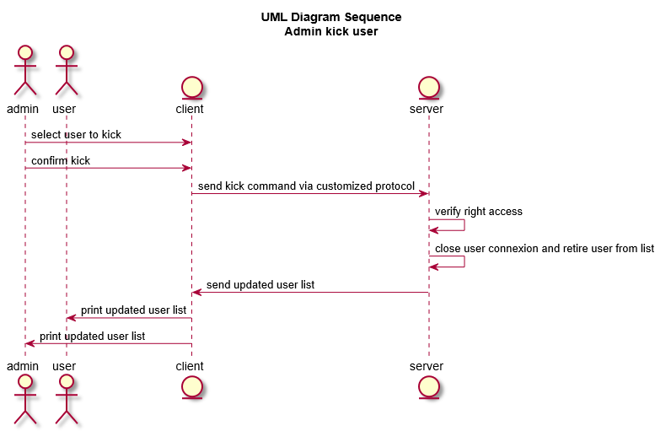
Administrator kick sequence
C:\Users\Thibault\Documents\NetBeansProjects\IRC_JEE\src\UML\AdminKickSequence.svg

Slide 9
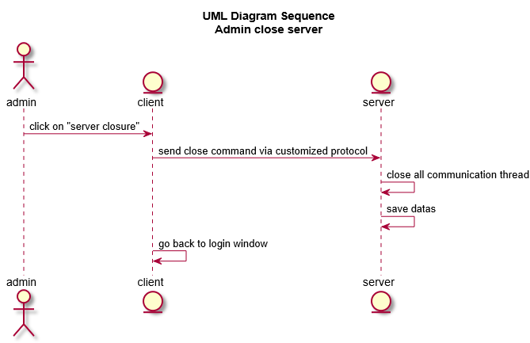
Administrator disconnect server sequence
C:\Users\Thibault\Documents\NetBeansProjects\IRC_JEE\src\UML\AdminDisconnectServerSequence.svg

Slide 10
Class Diagram

